Slide 1

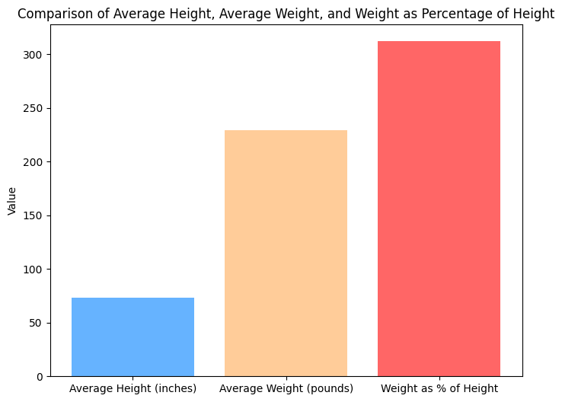
NFL Statistics and Basic Information
.The average height of an NFL player is 73.51 inches while the average weight of an NFL player is 229.22LBS.
.The most common birthplace of NFL players is Los Angeles, CA

